Slide 1
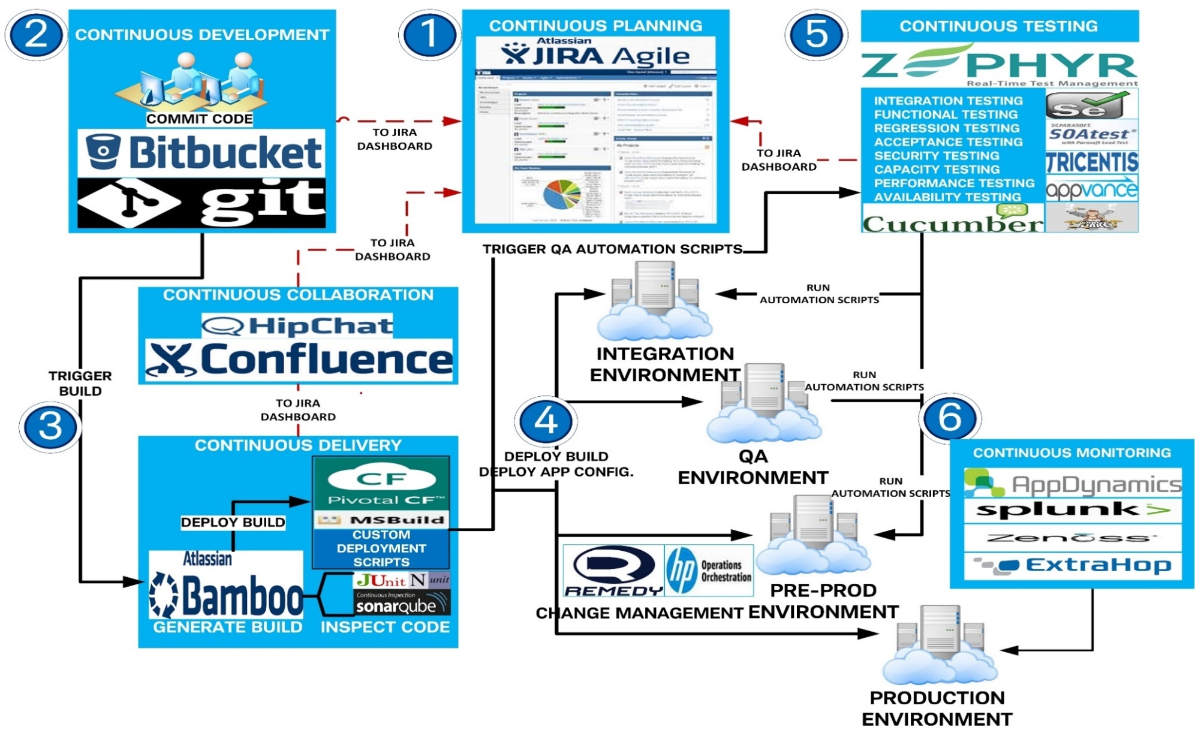
POC: Continuous Delivery Ecosystem of tools
Request for
Product features
Plan
Build
Deploy
Features available
to clients
Develop
Test
Monitor
1

